Slide 1



Opening a new gym in new york

Slide 2
introduction
This report has been commissioned with the purpose of providing some insight to any future companies that may want to open a new gym location within the heart of New York
The health and fitness industry is a booming industry, with repeated year on year growth. It is also far from its saturation point, with only just over 1 gym per 10,000 people within the city of New York. There still exists plenty of opportunity to create more locations for existing gym owners and new time buyers alike.

Slide 3
Things to consider
When trying to determine the best location to open a new gym, there are a number of factors to consider:
Existing gym locations - areas of high density are likely to already be saturated
Existing gym locations - areas of low density could be as a result of low demand
Cost - floor space rent
These will be factored into my final recommendation

Slide 4
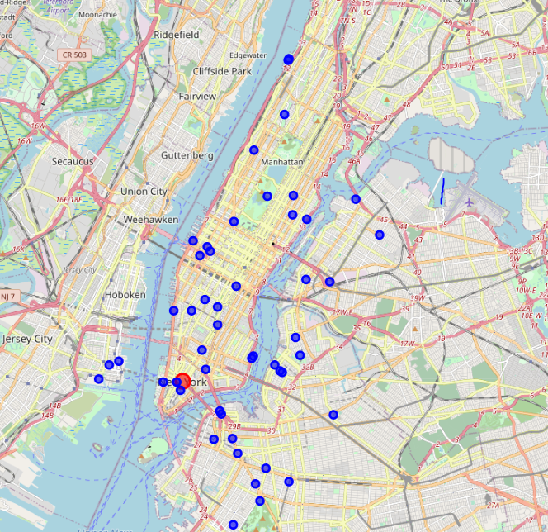
Existing gyms
Here is a map of central New York that denotes the current location of gyms within the city as found from the Foursquare API.
There are several locations of both high and low density

Slide 5
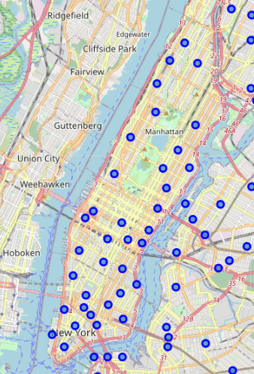
Areas to consider
Here is a map showing the areas within Manhattan to consider. As Manhattan has the highest population density in New York it is likely that those areas shall be the busiest.
I shall be applying the Machine Learning technique of K-means clustering in order to group these areas by similarity

Slide 6
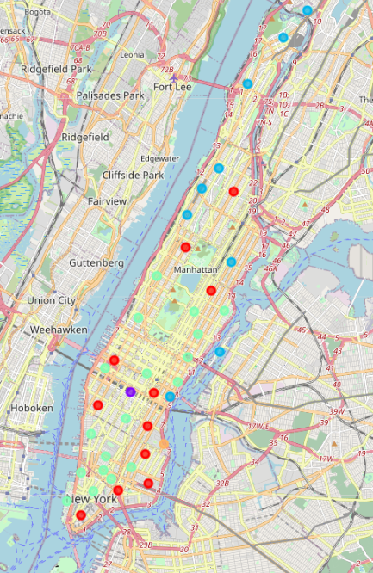
Areas to consider
Here you can see the neighbourhoods are now grouped together into 5 separate clusters based on their similarity to each other

Slide 7
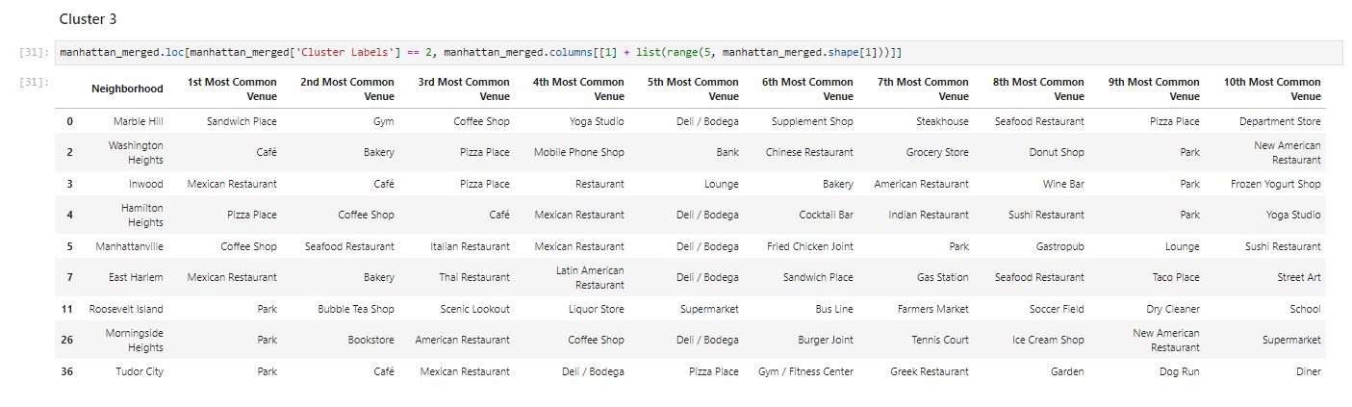
Area chosen
The area that I have chosen is most suitable, is East Harlem, denoted by index 7 in the table below. This area is similar to those in the rest of the cluster in terms of the types of venues that are contained within, yet no Gym is currently situated in that area. Therefore, it seems like a prime opportunity.

Slide 8
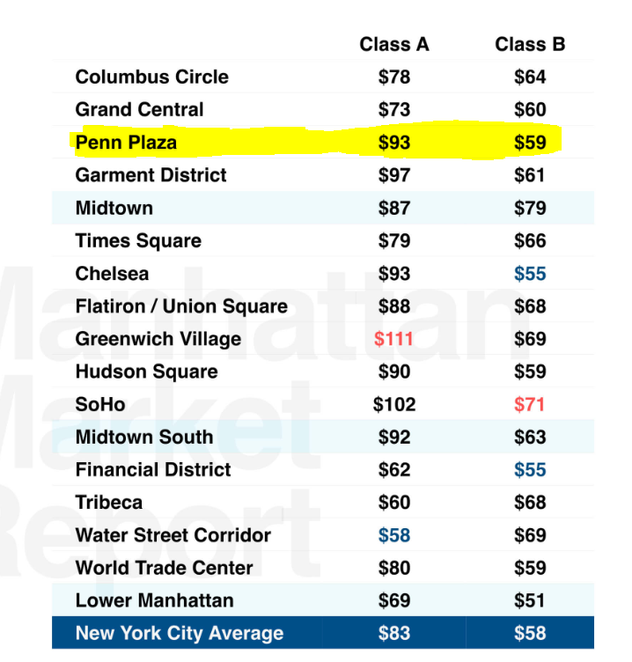
Considering cost
You can also see that the area chosen is not prohibitive from a cost perspective. It is almost equal to the average for New York in terms of Class B rent.

